Slide 1


Overview and concept

Slide 2

Epigenetics literally means "above" or "on top of" genetics. It refers to external modifications to DNA that turn genes "on" or "off." These modifications do not change the DNA sequence, but instead, they affect how cells "read" genes.
The term epigenetics refers to heritable changes in gene expression that does not involve changes to the underlying DNA sequence; a change in phenotype without a change in genotype.

Slide 3
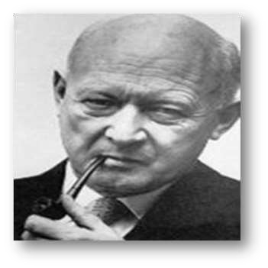
Conrad Waddington (1942) coined the term, “epigenetic”. He is known as father of epigenetics.
Conrad Hal Waddington
(1905 to 1975)

Slide 4

An epigenome consists of a record of the chemical changes to the DNA and histone proteins of an organism.
These changes can be passed down to an organism's offspring.
Changes in the epigenome can result in changes to the structure of chromatin and changes to the function of the genome.
The epigenome is a multitude of chemical compounds that can tell the genome what to do.

Slide 5
Epialleles
Alleles of a locus which have identical DNA sequences but display different epigenetic states and which have been proposed to influence a variety of phenotypes in plants and animals.

Slide 6



Molecular epigenetic mechanisms

Slide 7

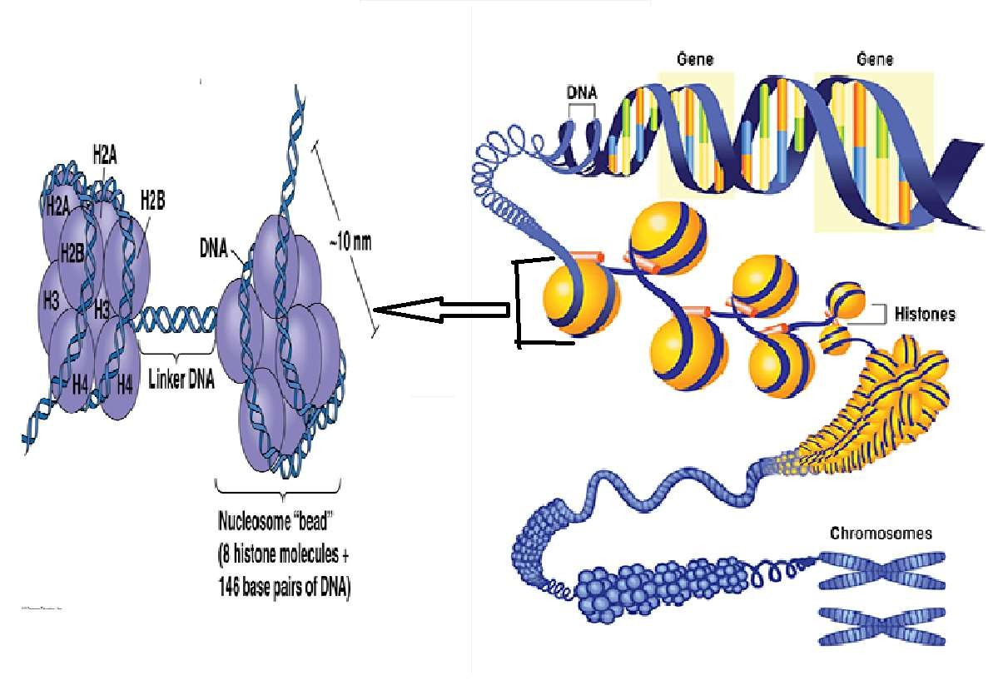

Slide 8
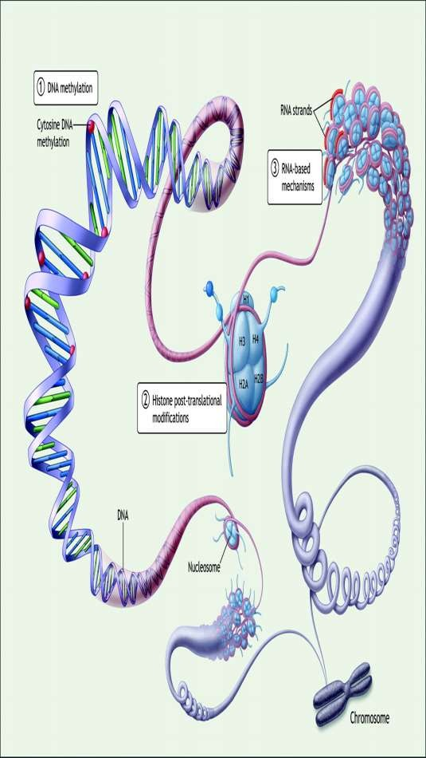
MECHANISMS
DNA methylation
Histone modifications
Acetylation
Methylation
Phosphorylation,
3. RNA mediated interference

Slide 9




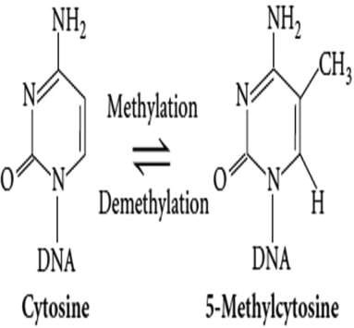
/40
DNA methylation
is an epigenetic cells to control
mechanism used by
gene expression.
DNA methylation is the addition of a methyl group to the 5th-carbon of
cytosine.
In eukaryotic cells,
this process is
carried out by a family
of DNA
methyltransferases enzymes, which transfers methyl groups from the methyl donor S-Adenosyl methionine (SAM) to the cytosine.
The resulting 5-methyl cytosine (5mC) is often repressive.

Slide 10
The repressive nature of 5mC is thought to inhibit the binding of DNA by transcription factors thus it is inaccessible for transcription

Slide 11
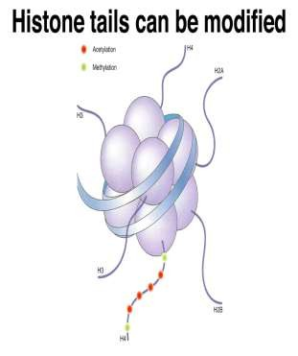
They are the chief protein components of chromatin, acting as spools around which DNA winds, and playing a role in gene regulation.
Histone modifications occur primarily on histone tails by three methods-
Methylation
Acetylation
Phosphorylation

Slide 12

Enzyme required
Histone methytransferases (HMTs)
KMT- Lysine methyl transferase
Methylation can result in activation or repression of genes.

Slide 13
b. Histone Acetylation & Deacetylation
Histone acetylation
– Histone acetyl transferases (HATs)
Adds acetyl groups to histone tails.
Reduces positive charge and weakens interaction of histones with DNA
Facilitates transcription by making DNA more accessible to RNA polymerase II
Histone deacetylation
– Histone deacetylases (HDACs)
Removes acetyl groups from histone tails
Increases interaction of DNA and histones
Represses transcription

Slide 14


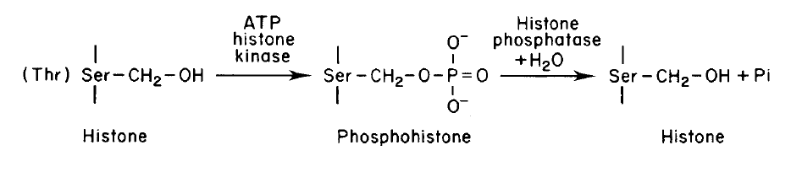
/40
Phosphorylation
Enzyme required – Protein kinase
Phosphorylation increase the negative charge on Histone as a result less interaction between DNA and histones that leads to chromatin de-condensation.
Dephosphorylation
Enzyme required - phosphatase
increase positive charge followed by chromatin condensation.

Slide 15

Also called post transcriptional gene silencing (PTGS)

Slide 16

/40
The field of epigenetics has rapidly developed into one of the most influential areas of scientific research.
Recent advances in analytical methodology have allowed for a significant expansion of what is known about genome wide mapping of DNA methylation and histone modifications.
Good knowledge of epigenetic mechanisms leads to better understanding of regulation of gene expression at transcriptional and post-transcriptional levels.
Epigenetic mechanisms such as DNA methylation and histone modification play a key role in development and stress response.

Slide 17

THANK YOU

